Slide 1
JOIN A B2B MEETING
ON ZOOM
2020.05

Slide 2
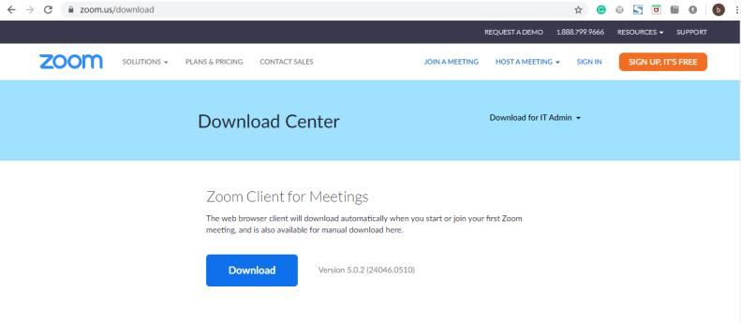
Download zoom on your computer
https://zoom.us/support/download
When download is done, double-click the ZoomInstaller to install it on your computer.

Slide 3
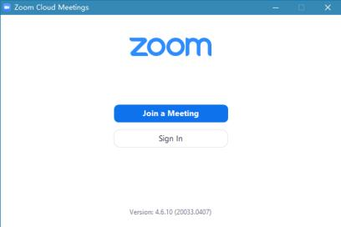
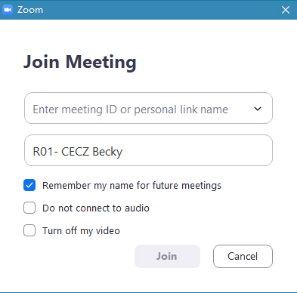
Always use computer to join a
Zoom B2B Meeting
Enter the meeting ID here
Please put your ZOOM CODE BEFORE YOUR NAME for the B2B meeting as requested by the organizer.
Then click Join

Slide 4
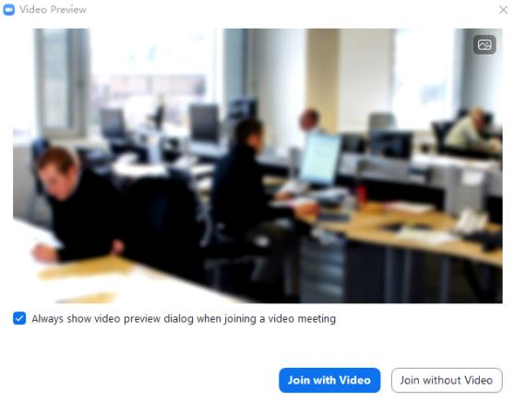
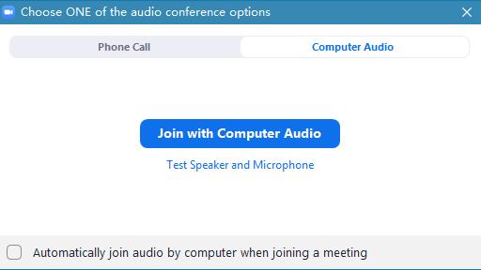
Check your speaker and microphone are working properly.
Before enter into the meeting room, check your web camera. It is advised to join the B2B meeting with your video on.

Slide 5
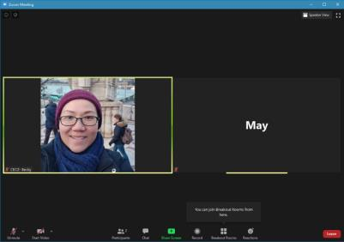
Now you have entered the the main session of the online conference.
The menu icons
Click participants to open the participants window
You will only see this breakout rooms icon when the host has started breakout rooms feature.
Leave
meeting
Click this icon to turn on or off your video camera
Click this icon to unmute or mute yourself

Slide 6
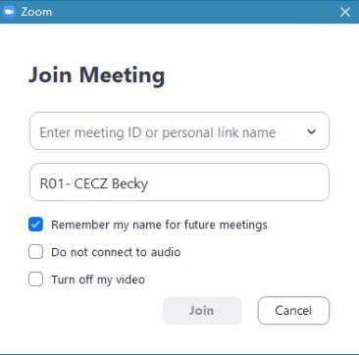
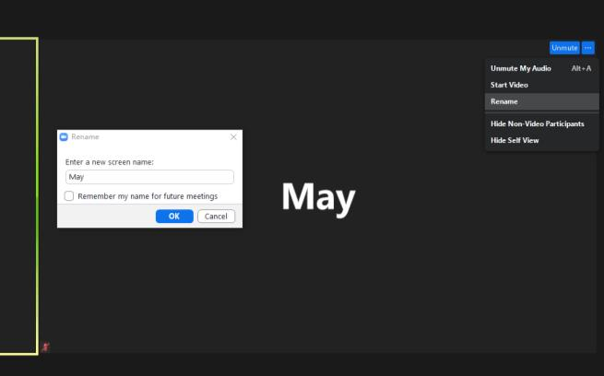
Naming is very important for online B2B meeting.
Here are THREE ways to rename yourself:
1. On entry
2. In the main session of the online conference, click top-right corner of your photo

Slide 7
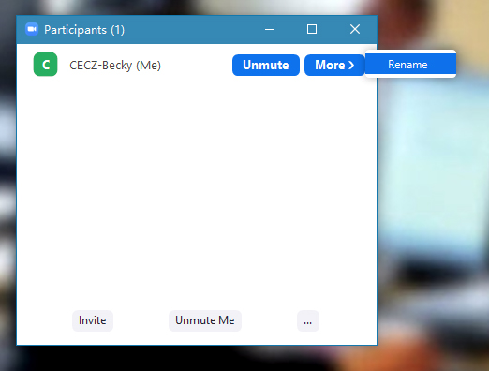
THREE ways to rename yourself:
3. On participants window
Next to your name, click more to rename yourself.

Slide 8
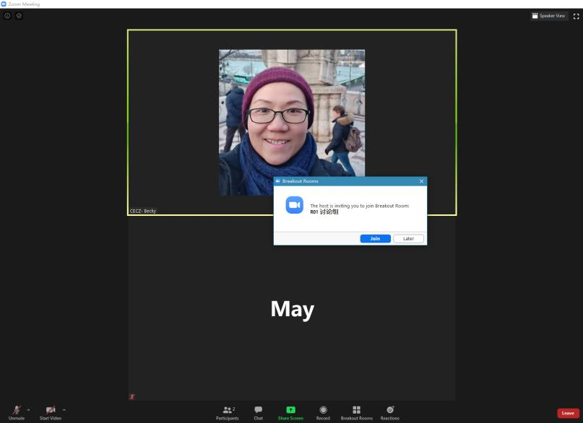
You are now in the main session of the online conference.
When the host has started breakout rooms feature, you will see a pop-up window to enter the room.
Please immediately press JOIN to enter.
Once the breakout rooms feature is on, you will see the breakout rooms icon at the bottom when you are in the main session of the online conference.
Here you can see you are in the main session of the online conference

Slide 9
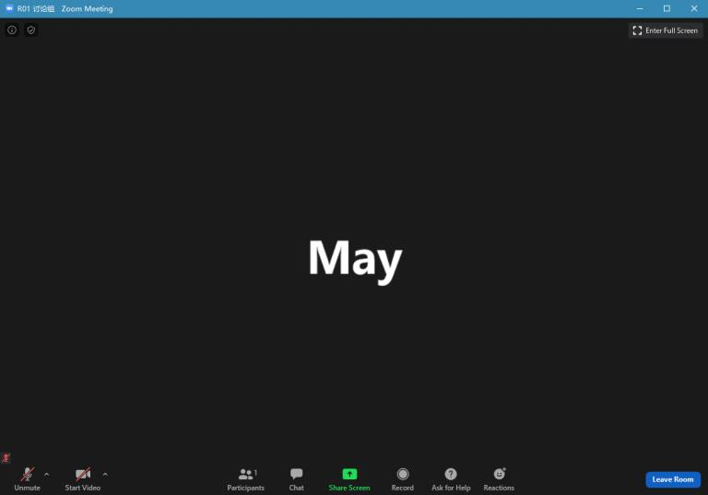
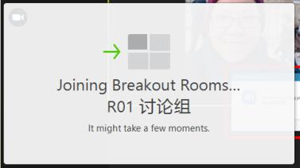
Once you click JOIN the breakout room, it will direct you to your assigned room.
When you are in the breakout room, you can use share screen to present PPT.
Here you can see you are in a breakout room R01
In the breakout room, you will NOT see the breakout room icon at the bottom.

Slide 10
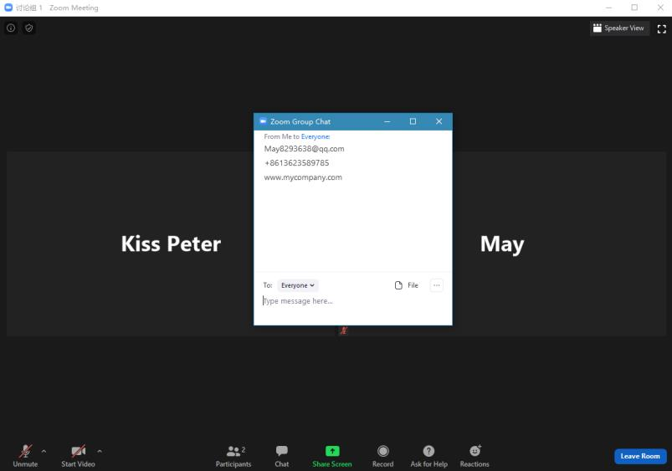
When you are in the breakout room, you can use chat to share your contact information to your potential partners.

Slide 11
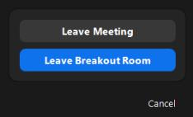
You should always follow the instruction of the organizer, whether to stay and wait for the host to assign you to your next breakout room, or to leave the room.
How to leave the
breakout room?
You can choose “Leave breakout room”. Please do not choose “Leave Meeting” until we finish the whole conference.

Slide 12
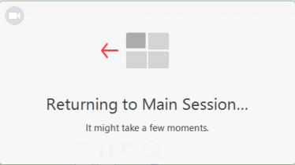
By leaving the breakout room, you will be directed back to the main session of the online conference
Here you can see you are in the main session of the online conference

Slide 13
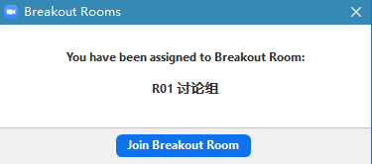
When you are in the main session of the online conference, when breakout rooms are opened by the host, you will see the breakout rooms icon at the bottom.
When you click it, you will see a pop-up window, by which you can enter into the breakout room that you were assigned.
This is important! If you accidentally leave the breakout room, you can use this method to go back to your breakout room. Pls note that the host cannot put you back to the breakout room. You need to click the breakout room icon and go back to your room.

Slide 14
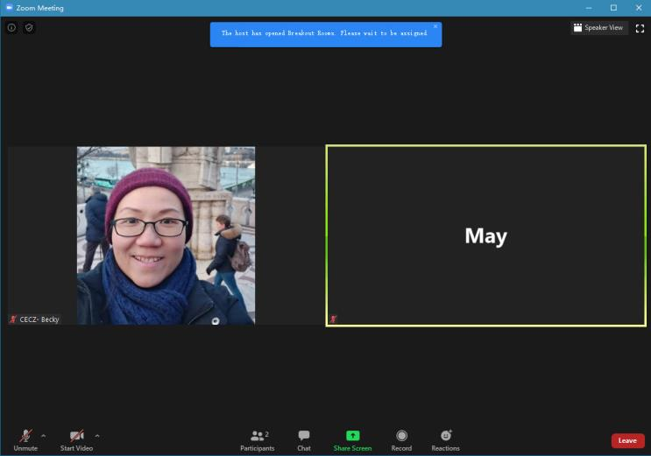
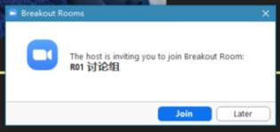
If you drop offline during the meeting, when you rejoin into the meeting, you will first land on the main session of the online conference.
The host has opened Breakout Rooms. Please wait to be assigned.
When the breakout rooms are opened and companies are negotiating in breakout rooms, you drop offline and come back into the meeting main session of the online conference, you should wait for the host to assign you back to the breakout room. Wait for the pop-up window to enter the breakout room.
Before you are assigned, you will NOT see the breakout rooms icon.

Slide 15
Your cooperation is very important for a successful online B2B meeting, we ask that you:
Find a good internet location
Use computer to join the zoom meeting (because some zoom features are not available on mobile phone)
Join the online meeting 30 minutes before its start
Test in advance that your video and audio are working properly
Stay muted during the opening speech and presentations
RENAME yourself, write your ASSIGNED ZOOM CODE BEFORE YOUR NAME (not after your name, it must be before your name so our host can put you into the right room) (see slide 6,7)
Wait patiently in the breakout room, when you have finished one negotiation, the host will reassign you to another room for another negotiation
Prepare in advance your contact information (Name, email, phone, website) in a word document, copy & paste in the chat window in the breakout room. (see slide 10)

